Slide 1
Majlis Ansarullah Monthly Meeting
May 2016
This slide deck contains images licensed for the purpose of this presentation only.
No one is permitted to use the images for any other use, without prior permission.

Slide 2
AGENDA
Recitation of the Holy Quran (24:56)
Pledge
Reminders: Recitation of HQ and Congregational Prayers
Monthly topic: Loyalty to Khilafat?
Health topic: Heart Healthy
National Reminders/announcements
Local Reminders/announcements
Dua

Slide 3
Why read the Holy Quran regularly?
HOLY QURAN IS THE FOUNTAINHEAD FOR YOUR SALVATION
The Holy Quran is the fountainhead for your salvation, for all your betterment and success. There is not even a single spiritual need which has not been met in this Holy Book. The supporter of the falsifier of your Faith on the Day of Judgment would be the Holy Quran; and apart from this book there is no other under heavens which can provide you with direct guidance. It is indeed a great blessing of God upon you that He has bestowed on you a book like this.
Our Teaching, Page 25-26

Slide 4
Watching Our Congregational Salat!
Without any valid excuse, missing congregational Salat is not an option!
Salat cannot be acceptable before Allah the Almighty unless it is offered in congregation (by males) except than that a person is sick or disabled.
– Hadhrat Musleh Maud (ra), 1946

Slide 5
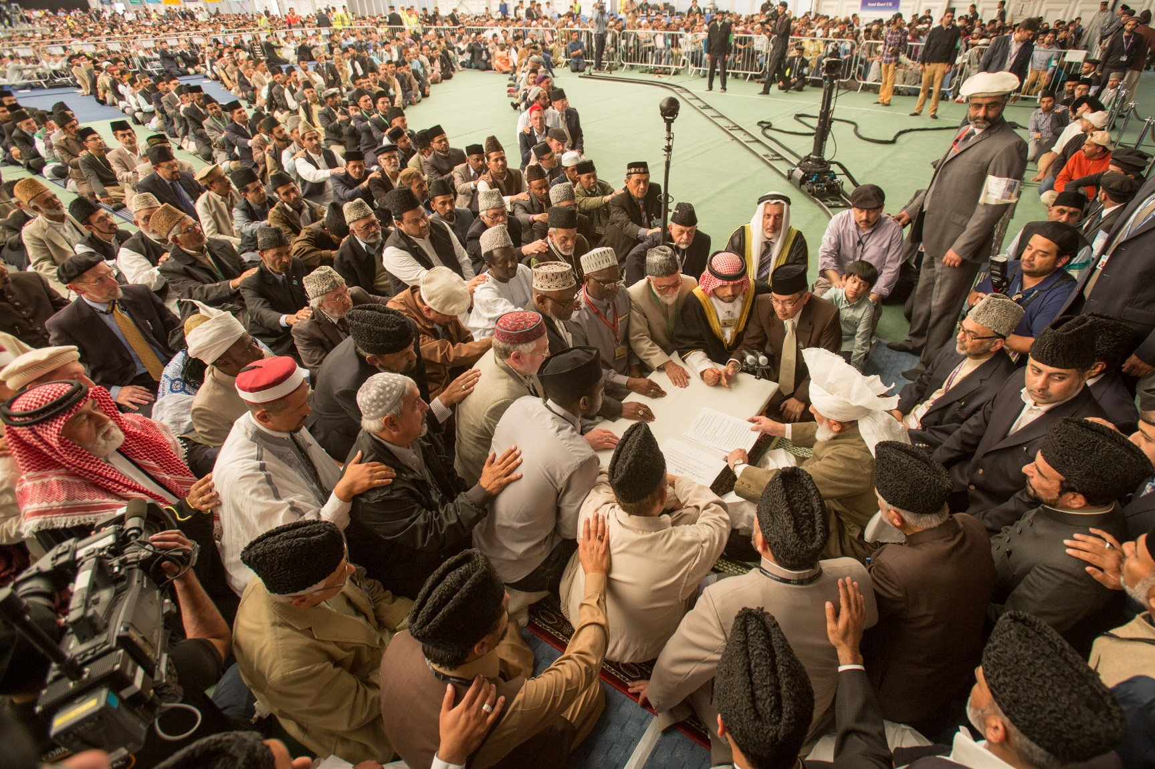
Increasing in Our Loyalty to Khilafat
Notes:
Need original image from spiritualfitness.us
Purposefully not mentioning anything about congregational salat

Slide 6
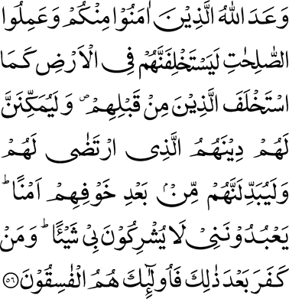
Click to listen the recitation
[24:56] Allah has promised to those among you who believe and do good works that He will surely make them Successors in the earth, as He made Successors from among those who were before them; and that He will surely establish for them their religion which He has chosen for them; and that He will surely give them in exchange security and peace after their fear; They will worship Me, and they will not associate anything with Me. Then whoso is ungrateful after that, they will be the rebellious.

Slide 7
Generally, we talk about Ayat-e-Istikhilaaf (the verse which was just translated) to describe blessings of Khilafat. What does it tell us about our responsibilities?
Share your thoughts

Slide 8
Hadhrat Musleh Maud (rz) explains:
The verse further says that the fulfillment of this promise will depend on the Muslims’ observing the Prayer and giving the Zakat, and on their obeying the messenger of God in all religious and temporal matters concerning the nation. When they will have fulfilled these conditions, the boon of Khilafat will be bestowed upon them and they will be made the leaders of nations; their state of fear will give place to a condition of safety and security, Islam will reign supreme in the world, and above all the oneness and unity of God – the real purpose and object of Islam – will become firmly established.
Five Volume Commentary, page 1869

Slide 9
Discussion I
Recently, Hazur (aba) made a special appeal to raise funds for a cause in which I do not fully believe. I generally commit to pay whatever I can afford for every Jamaat campaign but my heart is not fully satisfied with this one so I decided not to pay. Am I justified?

Slide 10
Option 1: Yes, because this cause will not benefit anyone in my opinion.
Option 2: Yes, and I should convince other Jamaat members not to pay either.
Option 3: I should give something in this cause just because Huzur (aba) has asked so even though I do not believe in it.
Option 4: I should pray that may Allah guide my heart to reconcile with this cause and enable me to contribute happily.

Slide 11
Guidance from Huzur (aba)
Another misunderstanding that Huzoor wished to remove, although he has previously explained it in his sermons on conditions of Bai’at, is about the pledge each Ahmadi makes with the Khalifa of the time to obey him in every ma’roof (good) decision. Some people assume that it is for them to define/interpret what is ma’roof and what is not. Let it be very clear that ma’roof has been defined by God and His Messenger (may peace and blessings of Allah be on him). Ma’roof decision is the decision made in light of the Holy Qur’an and Sunnah. According to the prophecy of the Holy Prophet (peace and blessings of Allah be on him) Khilafat was to be established on the precepts of Prophethood and according to the Promised Messiah (on whom be peace) Khilafat is everlasting. Thus, Khilafat cannot operate contrary to Qur’an and Sunnah and there is no option but to obey Khilafat, or prove that Khalifa of the time did such and such thing contrary to Qur’an and Sunnah.
Excerpt from Friday Sermon, June 6, 2014

Slide 12
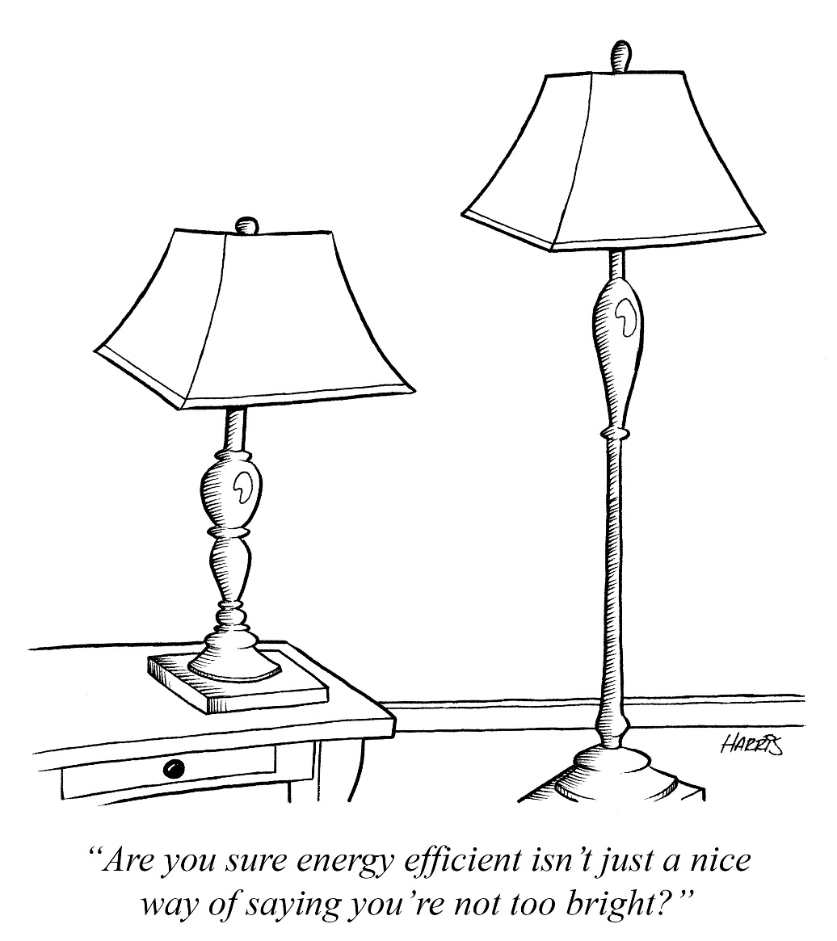
Discussion II
In recent elections, a person got elected as an office holder whom I know very well. Although, he is a representative of Khilafat, he is a weak person with limited secular and religious knowledge. There is no way I can obey him as I feel that my knowledge and experience is much more than him. What should I do?

Slide 13
Option 1: I should not obey him because it is not fair for such a person to be an officeholder.
Option 2: I should write to Amir Sahib to appoint someone with more experience in this office.
Option 3: I need to understand the phrase, “I hear and I obey”.
Option 4: I should pray that may Allah enable me to accept this person as representative of Khilafat.

Slide 14
Guidance from the Holy Prophet (saw)
‘Hear and Obey’
Wa’il bin Hujr (ra) reported: Salamah bin Yazid Al-Ju`f (ra) asked Messenger of Allah (saw): “O Prophet of Allah! Tell us, what you command us to do if there arises over us rulers who demand of us what is due to them and refuse us what is due to us.” Messenger of Allah (saw) turned away from him, but he repeated the same question. Thereupon Messenger of Allah (saw) said, “Listen to them and obey them. They are responsible for their obligations and you are accountable for yours.”
[Muslim]

Slide 15
Discussion III
Since I became an office holder, I have been working hard with all my knowledge, wisdom, and dedication. Finally, our Majlis which had never been previously ranked at national level, got first position last year. I am indeed grateful to my Allah who has given me this knowledge, wisdom and leadership ability to put my Majlis on victory stand. Is there any flaw in my thinking?

Slide 16
Option 1: I don’t see any flaw with my thinking as I worked hard for this.
Option 2: Everyone in our Majlis should be thankful to me for putting our Majlis on victory stand.
Option 3: It’s not my knowledge or leadership but the dedication and hard work of the entire Majlis which brought us this success.
Option 4: Its really our love and obedience to Khilafat for which Allah has blessed us.

Slide 17
Guidance from Huzur (aba)
Huzoor said to office-holders and workers of Jama'at that they have been blessed and enabled to serve the Jama'at merely owing to connection with Khilafat. He said it was credulous for people to assume that their knowledge, intellect or hard work was behind any good results/success. In matters of faith there can be no blessing at all without Khilafat as it has been historically proven. It is the love and loyalty to Khilafat that attracts God's grace and brings about good results/success because Khilafat is a system which God established. If office-holders feel any element of self-importance they should do istaghfar. Knowledge and skill can work in worldly matters but in Jama'at matters everything works due to the blessings of Khilafat.
(Excerpt from Friday Sermon, May 29, 2015)

Slide 18
A Short Video from Friday Sermon, June 6, 2014

Slide 19
Translation of the Video
To have one’s own opinion is not a bad thing. However, when regarding a matter, Khalifa of the time’s decision arrives that this is what to do, then it is necessary to totally forget your own opinion. Hazrat Mirza Bashir Ahmad Sahib used to say, “I hold my opinions regarding some matters and share them with the Khalifa of the time with reasons. However, if my opinion is rejected then, I don’t even think why it was rejected or what was my opinion? My opinion becomes the same as of the Khalifa of the time. With total obedience, I start obeying the commandment, which Khalifa of the time has given”. Hazrat Massih Maud (as) says that you should give yourself to the hands of the Imam like a dead body. Just like a dead body cannot move itself but is moved by the one who is bathing it, similarly, it is obligatory to the perfect obedient that he should give himself in the hands of the Imam. When this standard is achieved, only then we can fulfil the pledge of allegiance. Only then, we can fulfil the standards of obedience set by Allah and his Messenger. So every one of us who has taken the pledge of allegiance, will not only have to instill this thinking but also prove it with his actions.

Slide 20
Where do we stand?
اپنے جائزے لیں -
Self analyze yourself, KMV
In the last month, how many times did you write to Huzur?
How many Friday Sermons did you read or listen?
How many times, did you discuss Huzur’s Friday Sermons with your family?
Add the three numbers together.
(Keep it to yourself.. the “score” is for you!)

Slide 21
How to Improve?
اپنے اندر پاک تبدیلیاں پیدا کریں -
Bring about pious changes in yourself
0-1
2-5
>5
Keep striving hard to establish a strong connection with Khilafat by praying for yourself, and writing to Huzur.
Keep listening to the Friday Sermons regularly and try making Huzur’s directive part of your life
Continue to strengthen your connection with Khilafat and establish a best model for your family.

Slide 22
Health Topic: Heart Healthy

Slide 23
What is in your Heart?
Heart is the most important organ in your body. It is a strong muscle about the size of your palm that keeps life going
As we get older, the heart cannot beat as fast (during exercise or stress) as when you were younger
A common problem related to aging is “hardening of the arteries,” called arteriosclerosis
Heart Valves may become thicker and stiffer, causing leaks or decrease pumping efficiency of your heart
Many of the problems of heart and blood vessels are caused by disease, not by aging. There are things you can do to delay, lower, or possibly avoid or reverse your risk

Slide 24
Heart Diseases
There are many types heart diseases, the most common is the atherosclerotic heart disease which is caused by narrowed, blocked or stiffened blood vessels that prevent your heart, brain or other parts of your body from receiving enough blood.
Symptoms may include
chest pain (angina) shortness of breath pain Numbness, weakness or coldness in your legs or arms Pain in the neck, jaw, throat, upper abdomen or back Syncope or Pre-Syncope
Other Heart Diseases include those with diseased valves, infection, weakness of cardiac muscles or those due to abnormality of rhythm

Slide 25
How to be Heart Healthy?
Stop smoking - Quitting is the best way to reduce your risk of heart disease
Control your blood pressure Normal BP for most people is 140/90
Keep an eye your cholesterol - Your doctor will advise you what your goals cholesterol should be. In general the goal LDL (bad Cholesterol) may range from 70-130 depending on your risk factors. . Cholesterol guidelines have recently changed
Diabetes Tight blood sugar control can reduce the risk of heart disease
Exercise helps you achieve and maintain a healthy weight and control diabetes, elevated cholesterol and high blood pressure — all risk factors for heart disease
A heart-healthy diet based on fruits, vegetables and whole grains — and low in saturated fat, cholesterol, sodium and added sugar
Being overweight increases your risk of heart disease. A BMI of less than 25 and a waist circumference of 35 inches (88.9 centimeters) or less is the goal
Deal with depression Being depressed can increase your risk of heart disease

Slide 26
National Reminders
Four Priorities for 2016
At least 50% of Tajnid to attend monthly meetings where we discuss our Khalifa’s vision: “Save yourself and your families from a fire” in interactive discussions.
Help establish a culture of congregational Salat.
Help strengthen the love of Holy Quran.
More than 50% Tajnid to attend National Ijtima. The National Ijtema and Shura will take place in BRM on Sep 23-25, 2016. Please start planning now

Slide 27
Local Reminders
Local Reminders
Dua

